Slide 1


Shri Ramdeobaba College of Engineering & Management, Nagpur
Department of Computer Science & Engineering(AIML)
Session 2023-2024
SEMINAR
ON
SymptoSense – Symptom Classifier
Guided By : Dr. Amit Pimpalkar
Presented By :
Shreyas Raut
Samiran Gupta
Shubham Shivhare
Vedant Waghale

Slide 2
Content
Introduction
Motivation
Objectives
Literature Survey
Proposed Plan of Work(Flow chart, use case diagram)
Dataset/Model overview
Technology
Expected Outcome
Summary
References

Slide 3
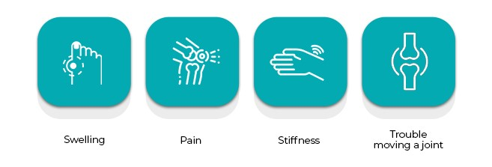
INTRODUCTION
What are Symptoms ?
Indication of a health issue.
Alerting them to potential health concerns.
A sign/clue of an body related issue.
Any feeling of illness or
physical or mental change that is caused by a particular
disease​

Slide 4
MOTIVATION
Effect
Delayed treatment
Cause
Disease Progression
Solution
Resource Allocations
Patient Empowerment
Delay medical Treatment​
Effective health resource
Individual proactive measures
Increase Complication

Slide 5
OBJECTIVES
NLP Model Devlopment
Integration with Healthcare Systems
Facilitate Highlight Retrieval for Doctors
Remote Patient Tracking
User Friendly Interface Design

Slide 6
LITERATURE SURVEY​​
 | Title | Approach/Model/Algorithm | Formula used | Source/Dataset | Findings and Relevance ,accuracy | Research Gap /Limitation
1 | 2022- Identifying Symptom Information in Clinical Notes | NimbleMiner Word2vec phrase2vec Random forest | Performance metrics recall, precision F-measure | Clinical notes from a single medical centre | Precision 0.75 - 0.96 f-measure = 0.80 - 0.96 Recall 0.81-0.99 | - Data from a single medical center - Evaluation only on a subset of symptom.
2 | 2021 - Limitations of Transformers on Clinical Text Classification | Word level -CNN , BlueBERT, Hierarchical Self-Attention Network. | - weigth,bias vectors Softmax function. -For Evaluation Precision ,recall and F1 score. | MIMIC-III Discharge Summaries. | - BlueBERT - precision 67% recall 54% , F1 score 61% - CNN - precision 73% recall 50% , F1 score 58%. | - Low signal-to-noise ratio . - BERT's tokenizer complexity
3 | 2023- Automated Extraction of Pain Symptom in Electronic Health Records | word2vec CLAMP model. | Precision, recall, and F1 measure | UConn Health John Dempsey Hospital EHR , 611,355 clinical notes | - Pain quantity rating - 8/10. - Identifying key pain-related parameters. | To use CUI code for better categorization of notes.

Slide 7
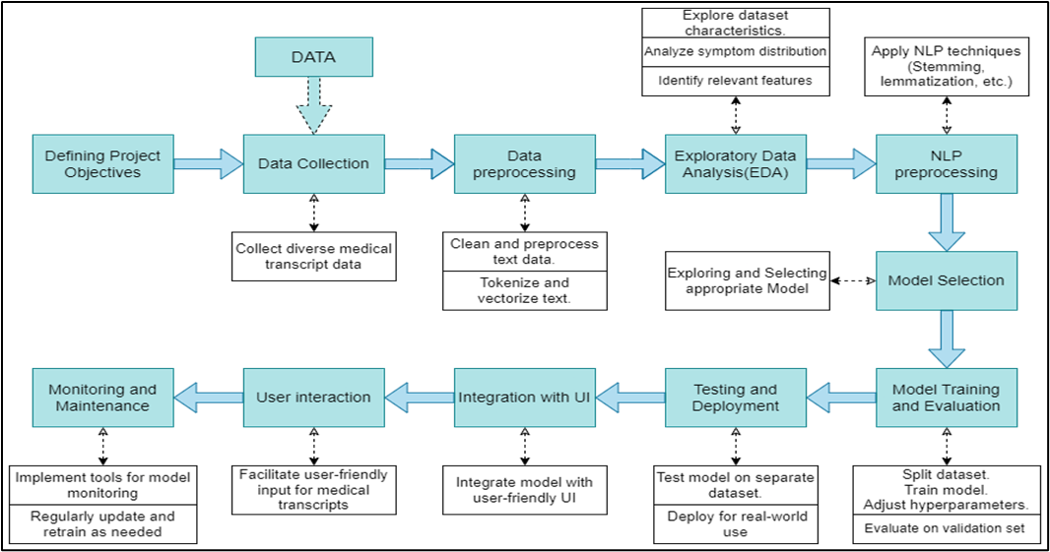
WORKFLOW

Slide 8
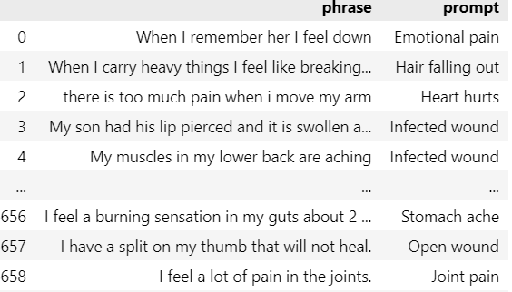
Dataset Overview
The Data Frame contains 6661 records.
Prompt attribute has 25 classes of symptoms.
There are only 124 unique speaker id.
80:20 training and testing

Slide 9
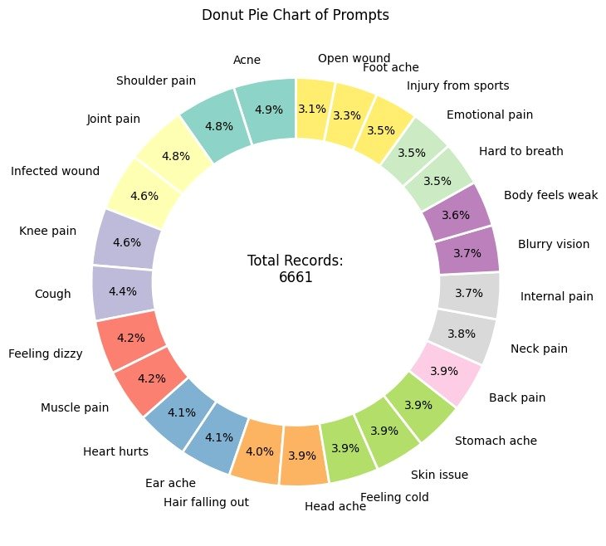
The Representation of the Prompts

Slide 10
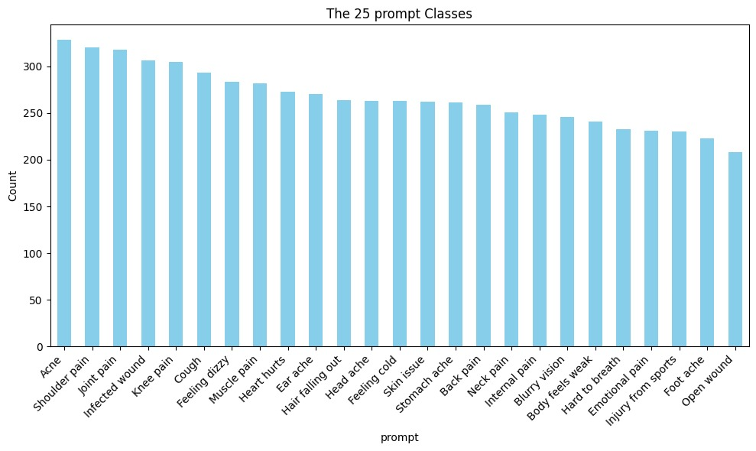
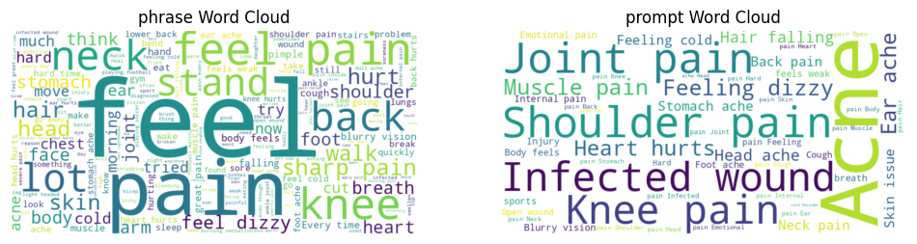
Class Distribution

Slide 11
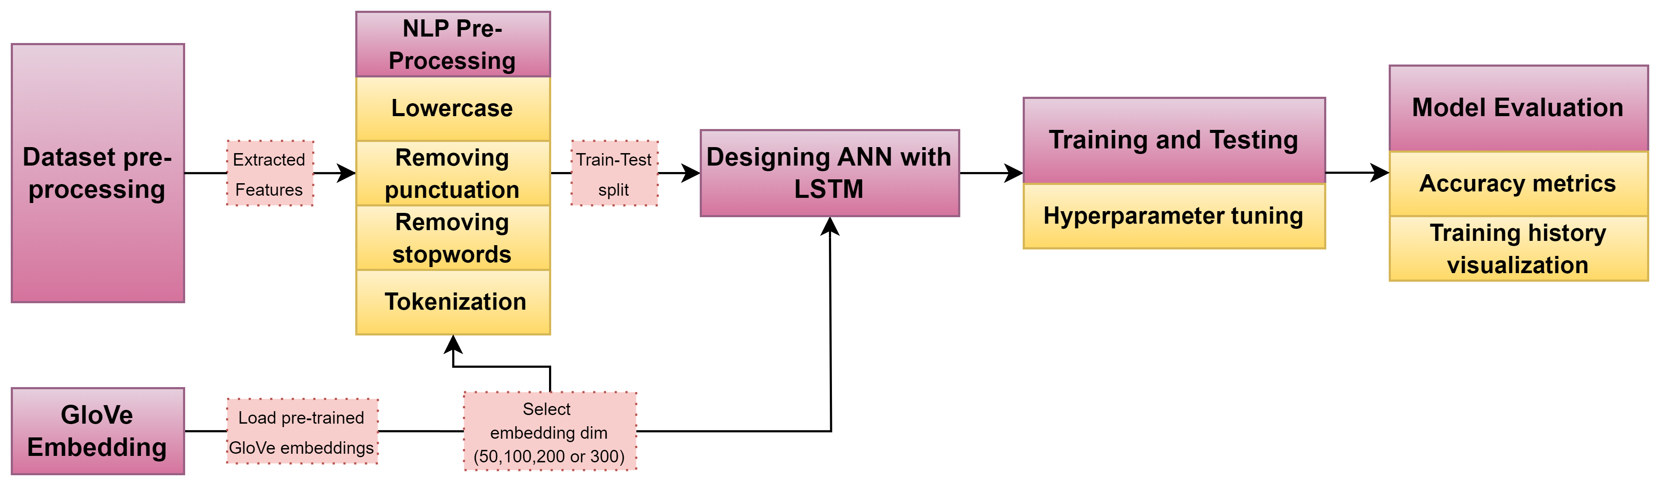
Model Overview
We have initially experimented on the preprocessed phrases by implementing:
LSTM (Long short-term memory) network based RNN.
GloVe (Global Vectors for Word Representation) embedding based preprocessing.
LSTM model on GloVe embedded data.
GloVe source : http://nlp.stanford.edu/data/glove.6B.zip
GloVe used : 300d

Slide 12
Observations:
Loss function - categorical_crossentropy or sparse_categorical_crossentropy
Output layer Activation - softmax
Model 1 using wordnet and LSTM:
 | Optimizer | Loss Function | Encoding Type | Test Loss | Accuracy
1 | Adam | categorical_crossentropy | One-hot | 0.030144 | 99.474871
2 | Adam | categorical_crossentropy | Two-hot | 0.077535 | 98.724681
3 | RMSProp | categorical_crossentropy | One-hot | 0.123513 | 97.974491
Model 2 using GloVe (ANN):
 | Optimizer | Loss Function | Encoding Type | Test Loss | Accuracy
1 | Adam | sparse_categorical_crossentropy | Label Encoder | 0.024434 | 99.70
2 | Adagrad | sparse_categorical_crossentropy | Label Encoder | 0.159308 | 99.249809
3 | RMSProp | sparse_categorical_crossentropy | Label Encoder | 0.026784 | 99.699926

Slide 13
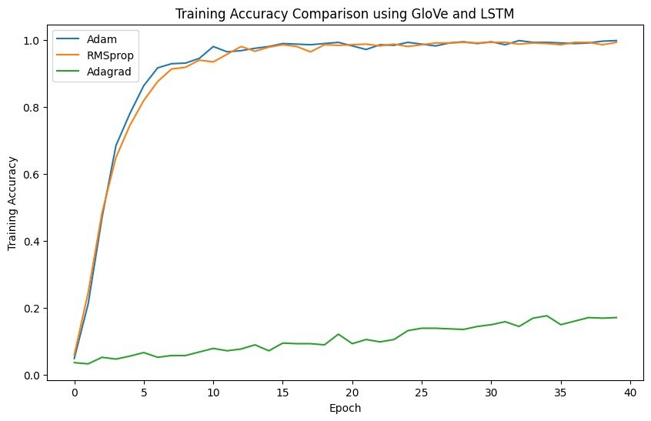

Slide 14
TECHNOLOGY
Programming
Language
Libraries and Frameworks
GPU
Python
NVidea Tesla T4
(Google Colab)
Data Manipulation and Analysis
Pandas
NumPy
IDE
NLP tools like
Visualization
Matplotlib Seaborn
Google Colab
LSTM
NLP Libraries
NLTK
Gensim
GloVe
Collaboration
Further Experimentation
(BERT,FastText)
Deep Learning Framework
Keras
Tensorflow
GitHub

Slide 15
EXPECTED OUTCOME
It features a user-friendly interface for easy input of symptoms.
The system accurately identifies and analyzes symptoms described in user-inputted text.
The system enhances clinical decision making by providing valuable insights and healthcare support to professionals.
It effectively classifies analyzed text into appropriate medical condition or categories.

Slide 16
SUMMARY
Our aim is to facilitate early disease detection.
We strive to develop a robust NLP model for symptom classification and implement remote patient tracking.
Our project uses text mining for symptom classification, contributing to early disease detection.
We have experimented on LSTM and GloVe and achieved accuracy above 99%.
Future scope include further experimentation and GUI development.

Slide 17
REFERENCES
A. D. Dave, G. Ruano, J. Kost, and X. Wang, “Automated Extraction of Pain Symptoms: A Natural Language Approach using Electronic Health Records,” Pain Physician, vol. 25, no. 2, pp. E245–E254, Mar. 2022, Available: https://pubmed.ncbi.nlm.nih.gov/35322976/
T. A. Koleck et al., “Identifying Symptom Information in Clinical Notes Using Natural Language Processing,” vol. 70, no. 3, pp. 173–183, May 2021, Available: https://www.ncbi.nlm.nih.gov/pmc/articles/PMC9109773/
Shang Gao , Mohammed Alawad, M. Todd Young , John Gounley ,"Limitations of Transformers on Clinical Text Classification " , vol. 25, no. 9, September 2021 ,Availiable https://pubmed.ncbi.nlm.nih.gov/33635801/
4. Amisha D. Dave, Gualberto Ruaño, Jonathan Kost , and Xiaoyan Wang, Automated Extraction of Pain Symptoms: A natural Language Approach using Electronic Health Records , March 2022,
Availiable https://pubmed.ncbi.nlm.nih.gov/35322976/https://pubmed.ncbi.nlm.nih.gov/35322976/
Dataset
“Medical Speech, Transcription, and Intent,” www.kaggle.com. https://www.kaggle.com/datasets/paultimothymooney/medical-speech-transcription-and-intent

Slide 18
Thank You

